Slide 1
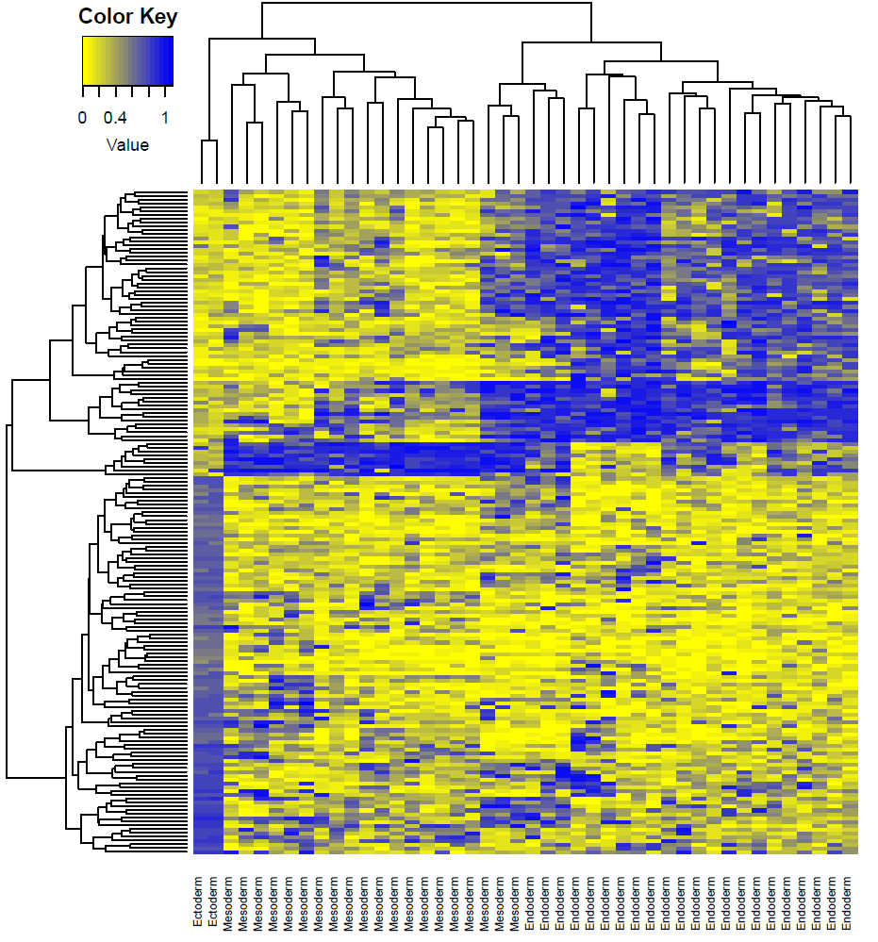
Methylation haplotype load distinguish the layer of the development
The development layers would be separated by layer specific methylation haplotype regions
Especially, ectoderm have completely different MHL regions compared with endoderm

